Slide 1
5
APPLICATIONS OF INTEGRATION
Copyright © Cengage Learning. All rights reserved.

Slide 2
5.6
Work
Copyright © Cengage Learning. All rights reserved.

Slide 3
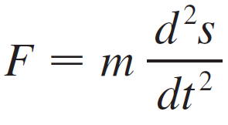

Work
The term work is used in everyday language to mean the total amount of effort required to perform a task.
In general, if an object moves along a straight line with
position function s(t), then the force F on the object (in the same direction) is given by Newton’s Second Law of Motion as the product of its mass m and its acceleration:

Slide 4

Work
In the SI metric system, the mass is measured in kilograms (kg), the displacement in meters (m), the time in seconds (s), and the force in newtons ( ).
In the case of constant acceleration, the force F is also constant and the work done is defined to be the product of the force F and the distance d that the object moves:
If F is measured in newtons and d in meters, then the unit for W is a newton-meter, which is called a joule (J).

Slide 5



Work
If F is measured in pounds and in d feet, then the unit for W is a foot-pound (ft-lb), which is about 1.36 J.
Let’s suppose that the object moves along the x-axis in the positive direction, from x = a to x = b, and at each point x between a and b a force f(x) acts on the object, where f is a continuous function.
We divide the interval [a, b] into n subintervals with endpoints x₀, x₁, …, x_{n} and equal width .
We choose a sample point in the i th subinterval [x_{i –1}, x_{i}]. Then the force at that point is .

Slide 6

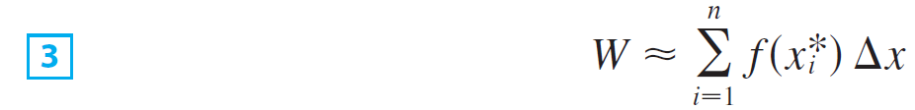
Work
If n is large, then is small, and since f is continuous, the values of f don’t change very much over the
interval [x_{i – 1}, x_{i}].
In other words, f is almost constant on the interval and so the work W_{i} that is done in moving the particle from x_{i – 1} to x_{i} is approximately given by Equation 2:
Thus we can approximate the total work by

Slide 7


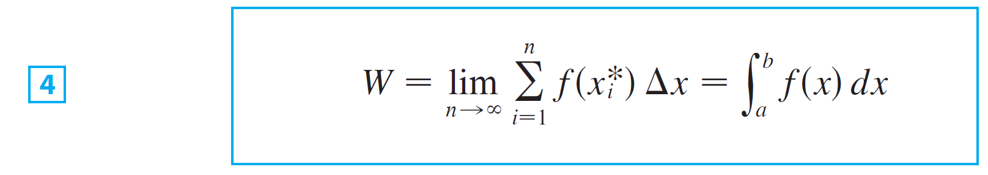
Work
It seems that this approximation becomes better as we make n larger.
Therefore we define the work done in moving the object from a to b as the limit of this quantity as .
Since the right side of is a Riemann sum, we recognize its limit as being a definite integral and so

Slide 8
Work
Hooke’s Law states that the force required to maintain a spring stretched x units beyond its natural length is proportional to x:
f(x) = kx
where k is a positive constant (called the spring constant).

Slide 9
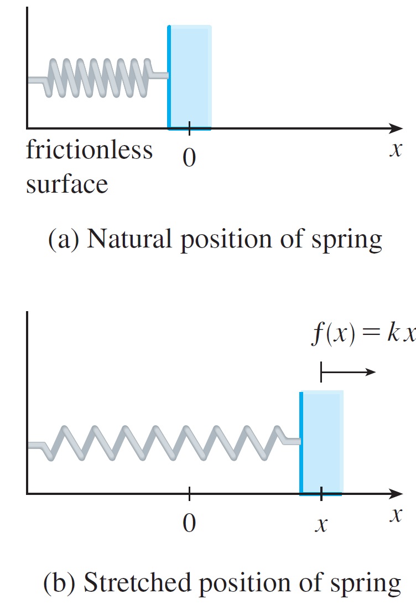
Work
Hooke’s Law holds provided that x is not too large (see Figure 1).
(a)
Natural position of spring
(b)
Stretched position of spring
Hooke’s Law
Figure 1

Slide 10
Example 2
A force of 40 N is required to hold a spring that has been stretched from its natural length of 10 cm to a length of 15 cm. How much work is done in stretching the spring from 15 cm to 18 cm?
Solution:
According to Hooke’s Law, the force required to hold the spring stretched x meters beyond its natural length is
f(x) = kx.
When the spring is stretched from 10 cm to 15 cm, the amount stretched is 5 cm = 0.05 m.

Slide 11

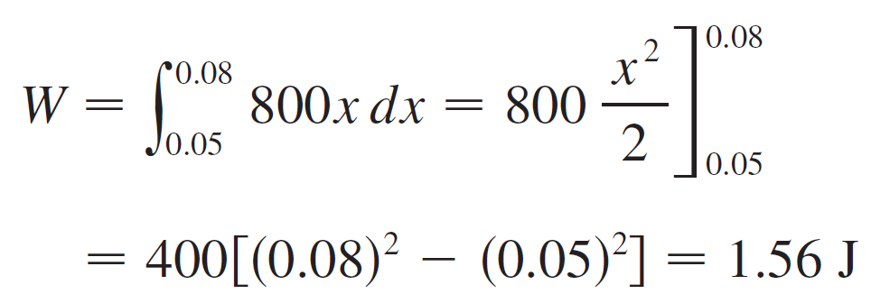
Example 2 – Solution
cont’d
This means that f(0.05) = 40, so
Thus and the work done in stretching the spring from 15 cm to 18 cm is

Slide 12
Example 2 – Solution
cont’d

